Slide 1
Computer Networks
UNIT 1

Slide 2
Contents
Introduction-Perspectives
Business Domains: Networks.
Applications: Resource Sharing, Client Server programming, e-commerce and digital communications.
Introduction: Networks, Network types. Network Models: TCP / IP protocol suite, Addressing, The OSI
Model. Transmission Modes: Parallel Transmission and Serial Transmission. Link Layer: Data Link
Control(DLC): DLC Services, Data Link Layer Protocols, High Level Data Link Control (HDLC), Point-to-
Point Protocol (PPP): Framing, Transition phases. Media Access Control (MAC): Random Access:
CSMA/CD,CSMA/CA.

Slide 3
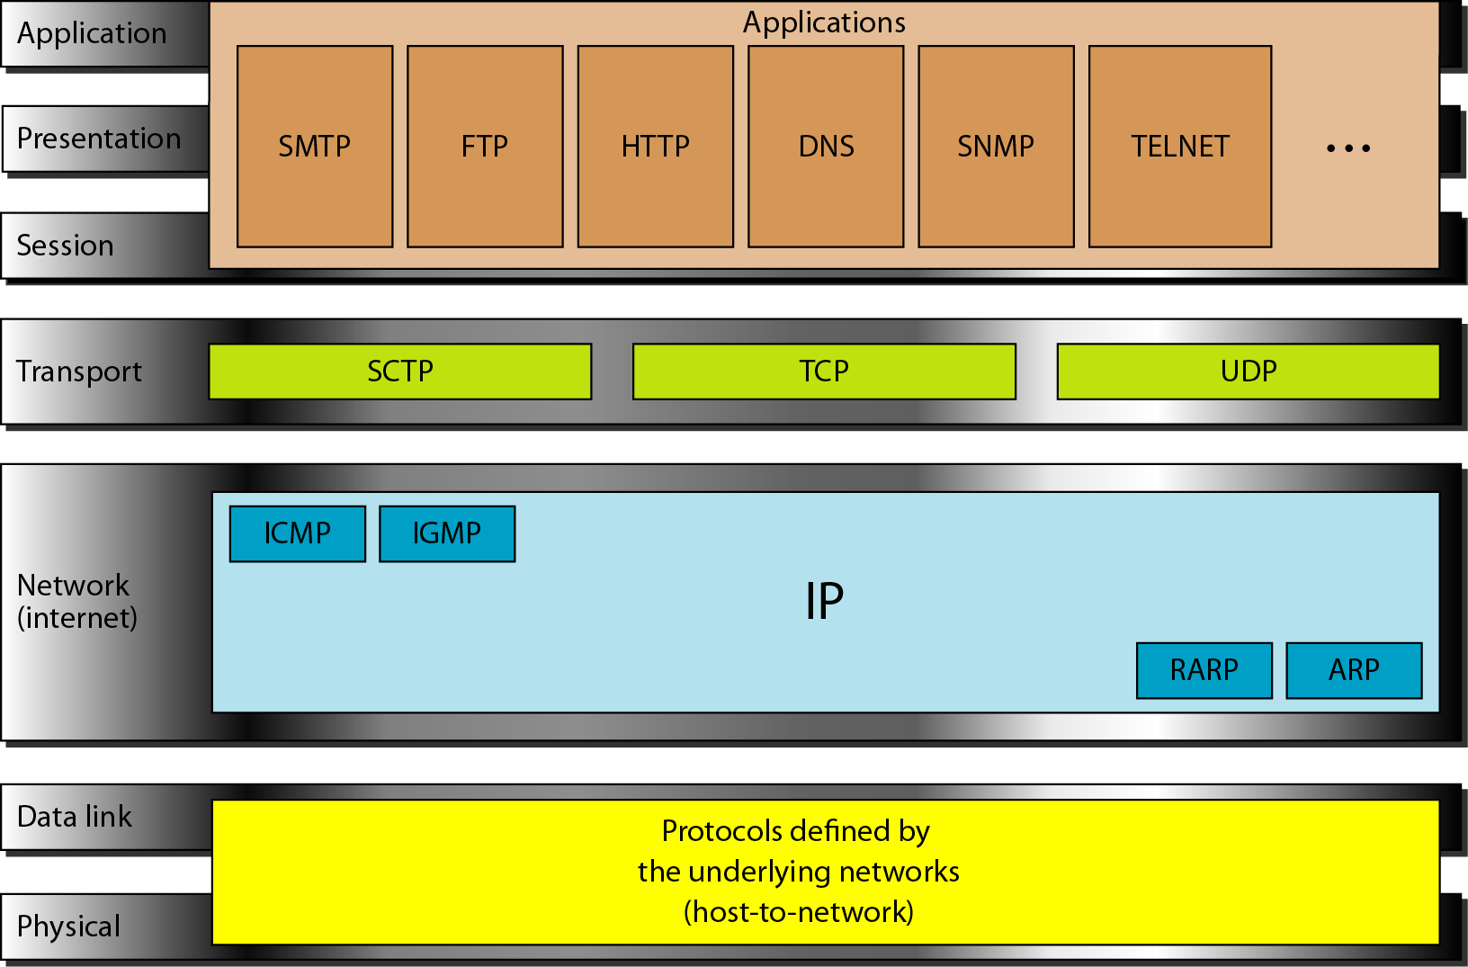
TCP/IP and OSI model

Slide 4
Switching
An internet is a switched network in which a switch connects at least two links together.
A switch needs to forward data from a network to another network when required.
The two most common types of switched networks are circuit-switched and packet-switched networks.

Slide 5
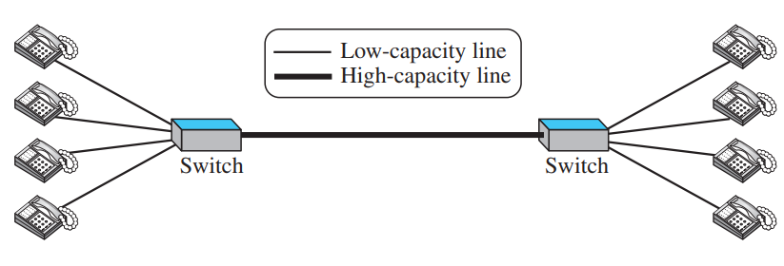
Circuit-Switched Network
In a circuit-switched network, a dedicated connection, called a circuit, is always available between the two end systems; the switch can only make it active or inactive.
circuit switching was very common in telephone networks in the past, although part of the telephone network today is a packet-switched network
Thick line is a high-capacity communication line that can handle four voice communications at the same time; the capacity can be shared between all pairs of telephone sets.

Slide 6
In the first case, all telephone sets are busy; four people at one site are talking with four people at the other site; the capacity of the thick line is fully used. In the second case, only one telephone set at one side is connected to a telephone set at the other side; only one-fourth of the capacity of the thick line is used.
This means that a circuit-switched network is efficient only when it is working at its full capacity; most of the time, it is inefficient because it is working at partial capacity.

Slide 7
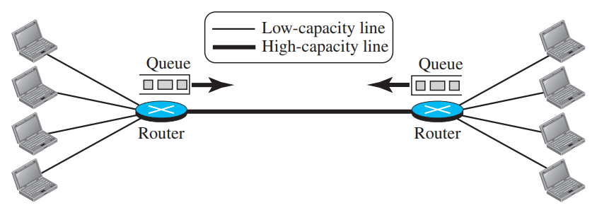
Packet-Switched Network
In a computer network, the communication between the two ends is done in blocks of data called packets.
In other words, instead of the continuous communication we see between two telephone sets when they are being used, we see the exchange of individual data packets between the two computers.
This allows us to make the switches function for both storing and forwarding because a packet is an independent entity that can be stored and sent later.

Slide 8
Now assume that the capacity of the thick line is only twice the capacity of the data line connecting the computers to the routers.
If only two computers (one at each site) need to communicate with each other, there is no waiting for the packets.
However, if packets arrive at one router when the thick line is already working at its full capacity, the packets should be stored and forwarded in the order they arrived.
The two simple examples show that a packet-switched network is more efficient than a circuit switched network, but the packets may encounter some delays

Slide 9
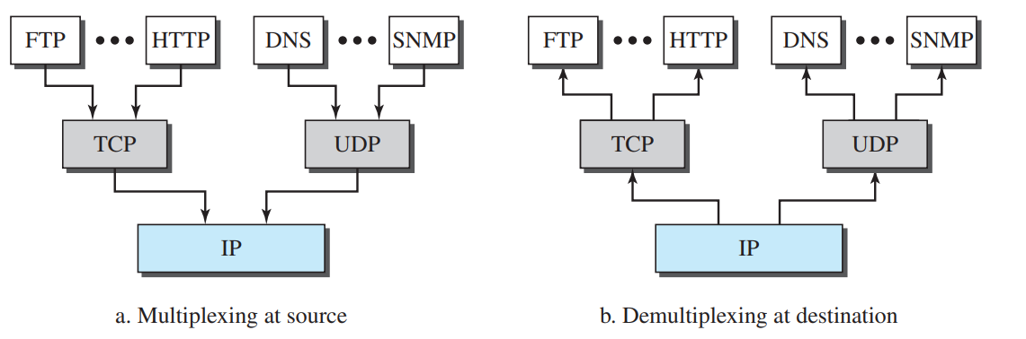
Multiplexing and Demultiplexing: with respect to layers

Slide 10
ADDRESSING
Four levels of addresses are used in an internet employing the TCP/IP protocols: physical, logical, port, and specific.

Slide 11
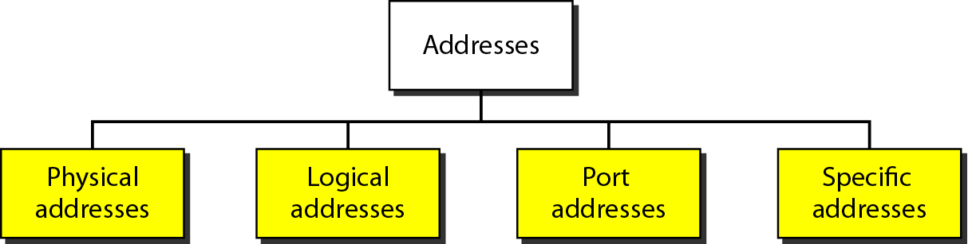
Figure 2.17 Addresses in TCP/IP

Slide 12
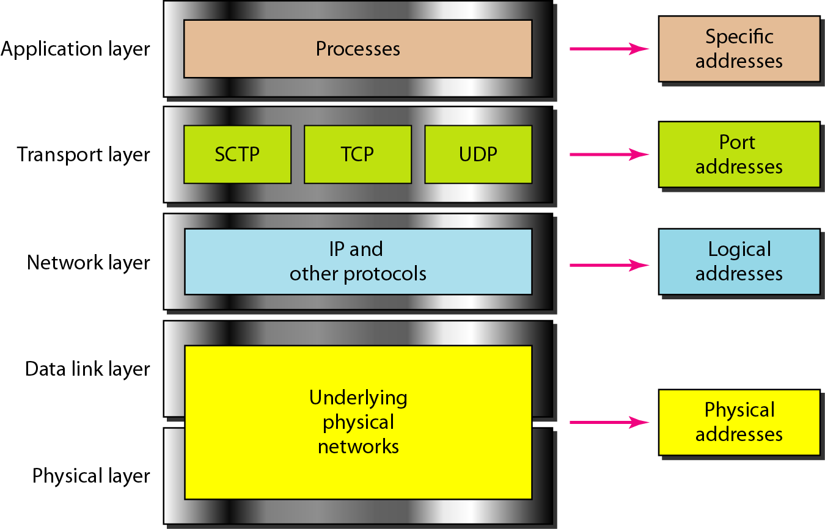
Figure 2.18 Relationship of layers and addresses in TCP/IP

Slide 13
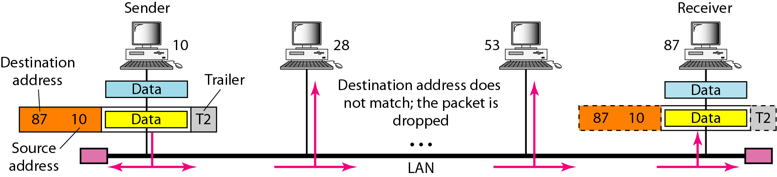
Addressing

Slide 14
Most local-area networks use a 48-bit (6-byte) physical address written as 12 hexadecimal digits; every byte (2 hexadecimal digits) is separated by a colon, as shown below:
07:01:02:01:2C:4B
A 6-byte (12 hexadecimal digits) physical address.

Slide 15
Figure 2.20 shows a part of an internet with two routers connecting three LANs. Each device (computer or router) has a pair of addresses (logical and physical) for each connection. In this case, each computer is connected to only one link and therefore has only one pair of addresses. Each router, however, is connected to three networks (only two are shown in the figure). So each router has three pairs of addresses, one for each connection.

Slide 16
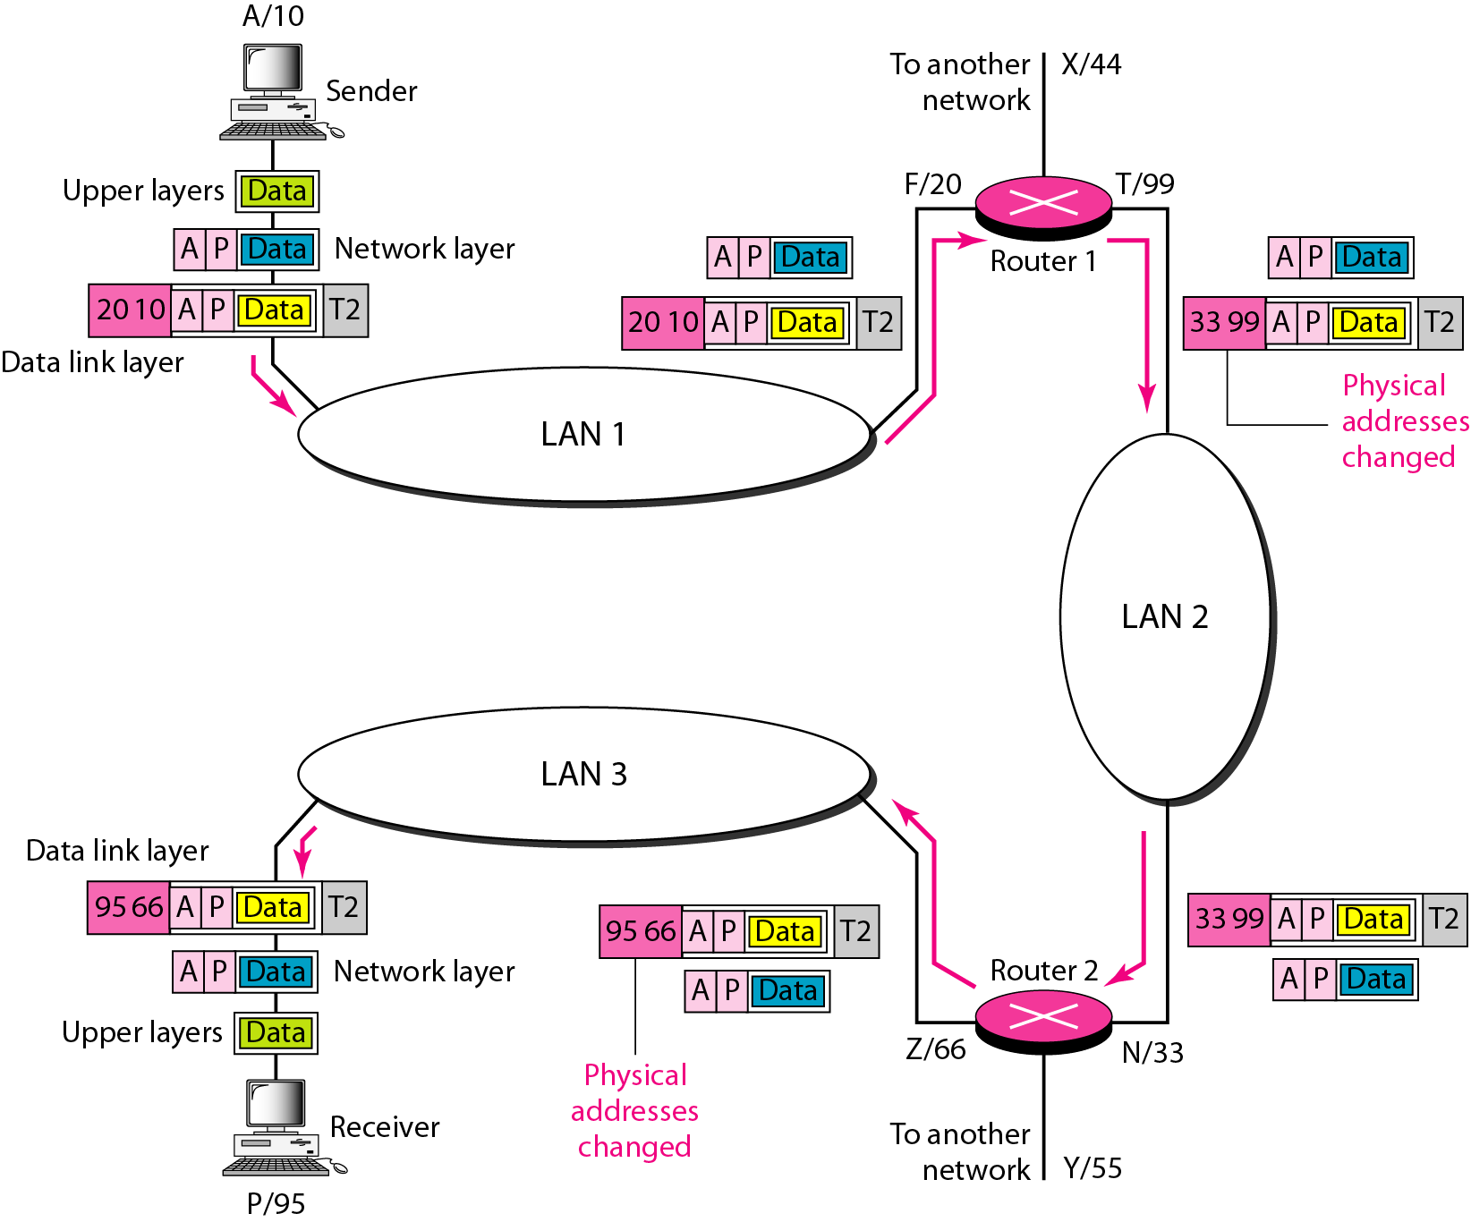
Figure 2.20 IP addresses

Slide 17
Figure 2.21 shows two computers communicating via the Internet. The sending computer is running three processes at this time with port addresses a, b, and c. The receiving computer is running two processes at this time with port addresses j and k. Process a in the sending computer needs to communicate with process j in the receiving computer. Note that although physical addresses change from hop to hop, logical and port addresses remain the same from the source to destination.

Slide 18
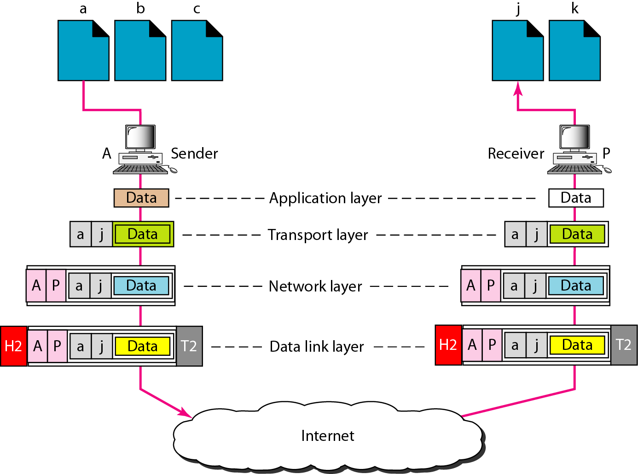

Slide 19
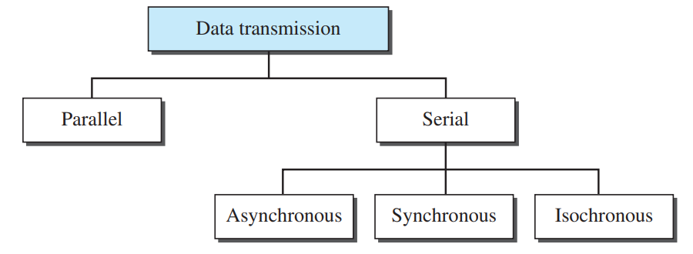
TRANSMISSION MODES
The transmission of binary data across a link can be accomplished in either parallel or serial mode.
In parallel mode, multiple bits are sent with each clock tick. In serial mode, 1 bit is sent with each clock tick.

Slide 20
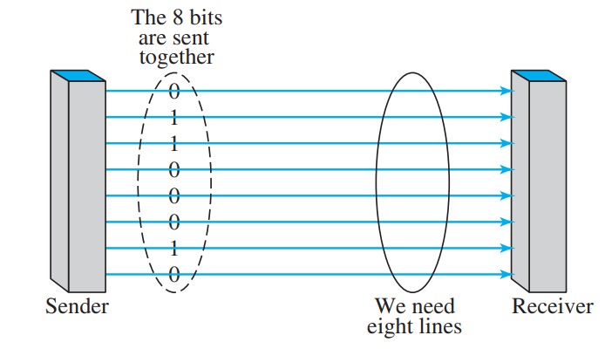
Parallel Transmission
By grouping, we can send data n bits at a time instead of 1.
This is called parallel transmission.
The mechanism for parallel transmission is a conceptually simple one: Use n wires to send n bits at one time.
That way each bit has its own wire, and all n bits of one group can be transmitted with each clock tick from one device to another.

Slide 21
The advantage of parallel transmission is speed.
All else being equal, parallel transmission can increase the transfer speed by a factor of n over serial transmission.
But there is a significant disadvantage: cost.
Parallel transmission requires n communication lines (wires in the example) just to transmit the data stream.
Because this is expensive, parallel transmission is usually limited to short distances

Slide 22
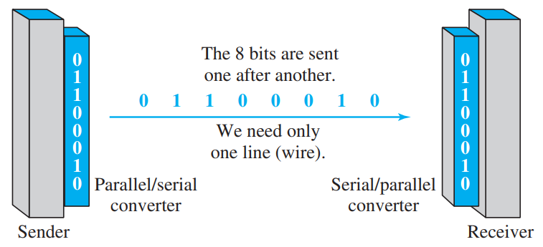
Serial Transmission
In serial transmission one bit follows another, so we need only one communication channel rather than n to transmit data between two communicating devices

Slide 23
The advantage of serial over parallel transmission is that with only one communication channel, serial transmission reduces the cost of transmission over parallel by roughly a factor of n
Since communication within devices is parallel, conversion devices are required at the interface between the sender and the line (parallel-to-serial) and between the line and the receiver (serial-to-parallel).

Slide 24
Serial transmission occurs in one of three ways: asynchronous, synchronous, and isochronous.
Asynchronous Transmission:
It is so named because the timing of a signal is unimportant. Instead, information is received and translated by agreed upon patterns.
Patterns are based on grouping the bit stream into bytes.
To alert the receiver to the arrival of a new group, therefore, an extra bit is added to the beginning of each byte.
This bit, usually a 0, is called the start bit.
To let the receiver know that the byte is finished, 1 or more additional bits are appended to the end of the byte.
These bits, usually 1s, are called stop bits.
By this method, each byte is increased in size to at least 10 bits, of which 8 bits is information and 2 bits or more are signals to the receiver.
In addition, the transmission of each byte may then be followed by a gap of varying duration.
This gap can be represented either by an idle channel or by a stream of additional stop bits

Slide 25
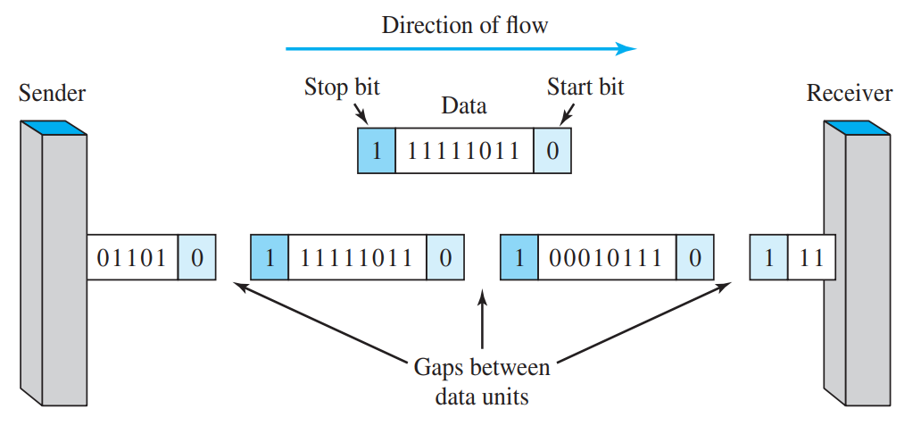
Asynchronous here means “asynchronous at the byte level,” but the bits are still synchronized; their durations are the same.
When the receiver detects a start bit, it sets a timer and begins counting bits as they come in. After n bits, the receiver looks for a stop bit.
As soon as it detects the stop bit, it waits until it detects the next start bit
Sending an email or text is an example of an asynchronous

Slide 26
The addition of stop and start bits and the insertion of gaps into the bit stream make asynchronous transmission slower than forms of transmission that can operate without the addition of control information.
But it is cheap and effective, two advantages that make it an attractive choice for situations such as low-speed
For example, the connection of a keyboard to a computer is a natural application for asynchronous transmission.

Slide 27
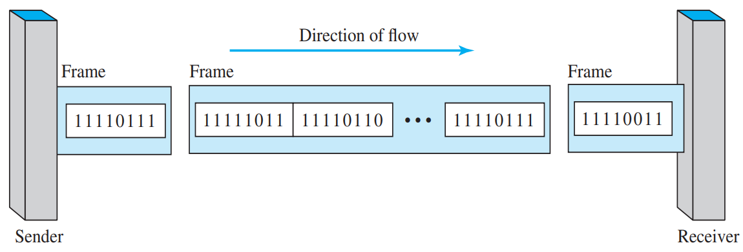
Synchronous Transmission
In synchronous transmission, we send bits one after another without start or stop bits or gaps. It is the responsibility of the receiver to group the bits.
If the sender wishes to send data in separate bursts, the gaps between bursts must be filled with a special sequence of 0s and 1s that means idle.
The receiver counts the bits as they arrive and groups them in 8-bit units.

Slide 28
Without gaps and start and stop bits, there is no built-in mechanism to help the receiving device adjust its bit synchronization midstream.
Timing becomes very important, therefore, because the accuracy of the received information is completely dependent on the ability of the receiving device to keep an accurate count of the bits as they come in.
The advantage of synchronous transmission is speed.
For this reason, it is more useful for high-speed applications such as the transmission of data from one computer to another. Byte synchronization is accomplished in the data-link layer.
Although there is no gap between characters in synchronous serial transmission, there may be uneven gaps between frames.
Video Conferencing, Chat Rooms, and Telephonic Conversations.

Slide 29
Isochronous
In real-time audio and video, in which uneven delays between frames are not acceptable, synchronous transmission fails.
For example, TV images are broadcast at the rate of 30 images per second; they must be viewed at the same rate.
If each image is sent by using one or more frames, there should be no delays between frames.
For this type of application, synchronization between characters is not enough; the entire stream of bits must be synchronized.
The isochronous transmission guarantees that the data arrive at a fixed rate.

Slide 30
Link Layer
Data Link Control(DLC): DLC Services
Data Link Layer Protocols
High Level Data Link Control (HDLC)
Point-to- Point Protocol (PPP): Framing, Transition phases.
Media Access Control (MAC):
Random Access: CSMA/CD,CSMA/CA

Slide 31
FRAMING
The data link layer needs to pack bits into frames, so that each frame is distinguishable from another. Our postal system practices a type of framing. The simple act of inserting a letter into an envelope separates one piece of information from another; the envelope serves as the delimiter.
Fixed-Size Framing Variable-Size Framing

Slide 32
Framing
Fixed Size Framing : frame size itself is delimeter. Ex: ATM Networks using Cells
Variable Size Framing: need to define boundaries explicitly. Two approaches are: Character-Oriented, Bit Oriented

Slide 33
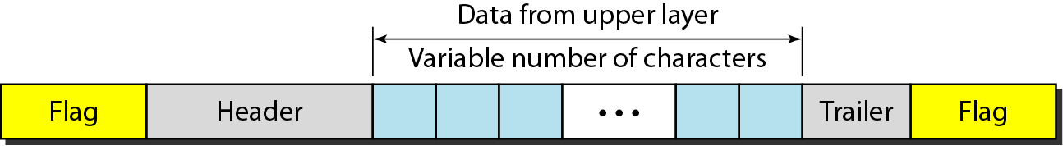
A frame in a character-oriented protocol(Byte Oriented )

Slide 34
Character Oriented Framing
Popular for text transmission

Slide 35
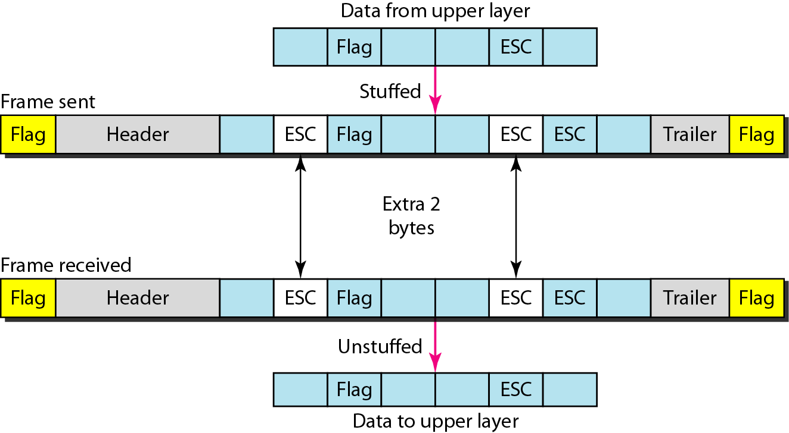
Byte stuffing and unstuffing

Slide 36
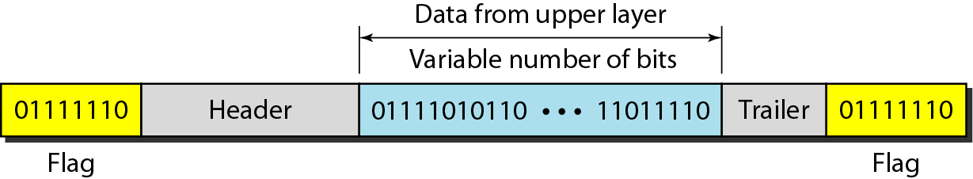
A frame in a bit-oriented protocol

Slide 37
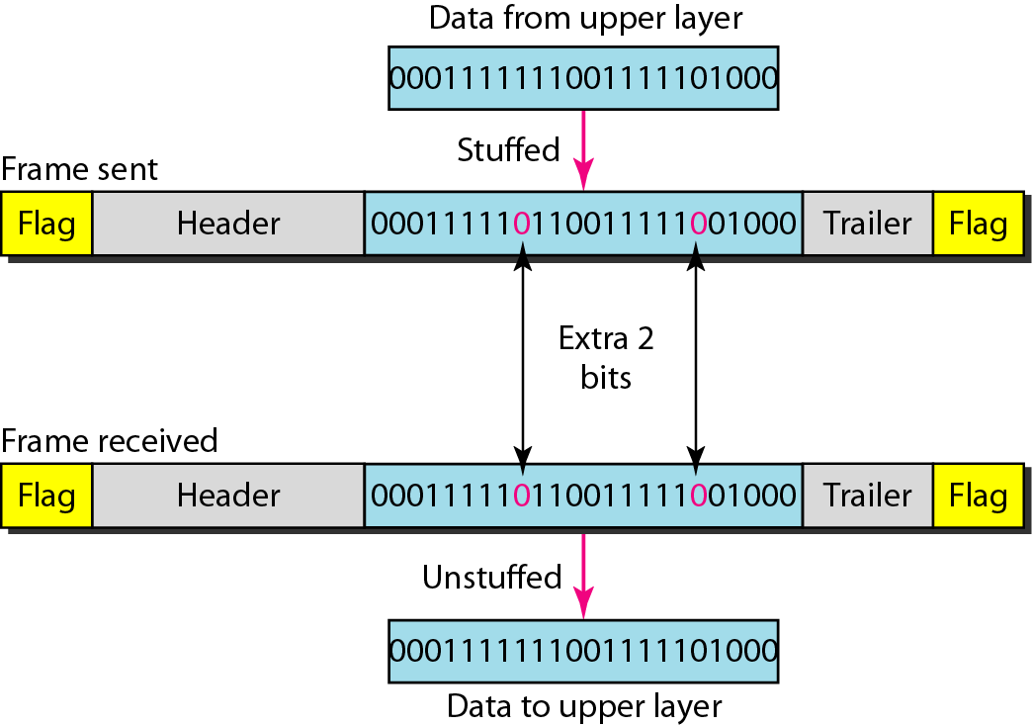
Bit stuffing and unstuffing

Slide 38
FLOW AND ERROR CONTROL
The most important responsibilities of the data link layer are flow control and error control. Collectively, these functions are known as data link control.
Flow Control: buffers
Error Control: CRC
Connectionless protocol
Connection oriented protocol

Slide 39
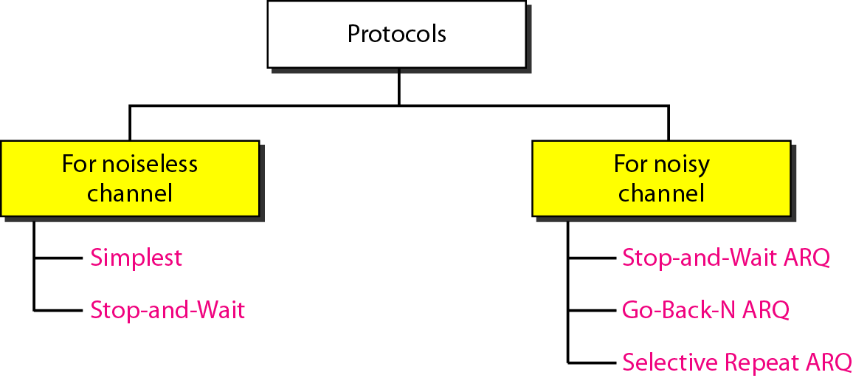
PROTOCOLS
data link layer can combine framing, flow control, and error control to achieve the delivery of data from one node to another. The protocols are normally implemented in software by using one of the common programming languages.

Slide 40
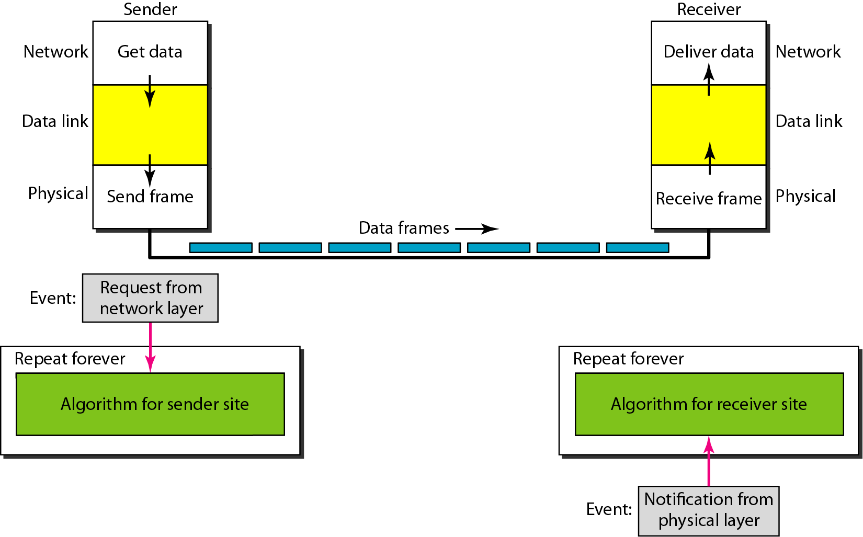
The design of the simplest protocol with no flow or error control

Slide 41
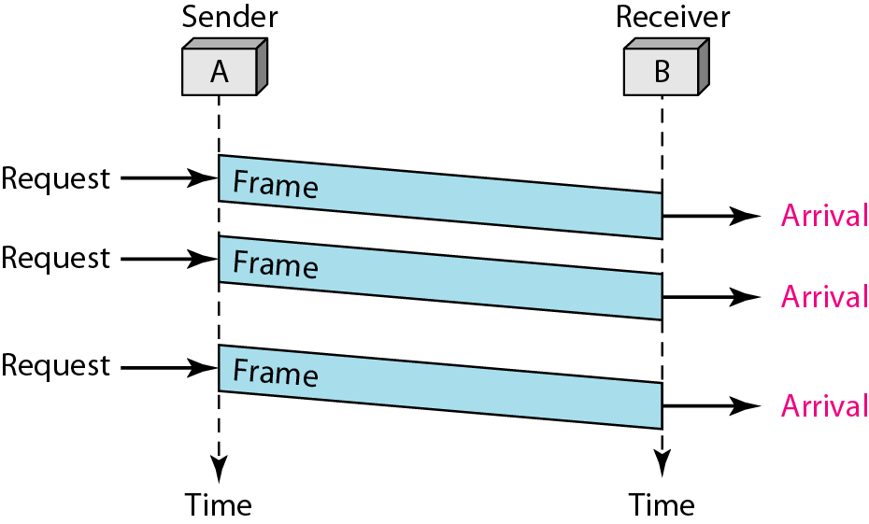
Flow diagram

Slide 42
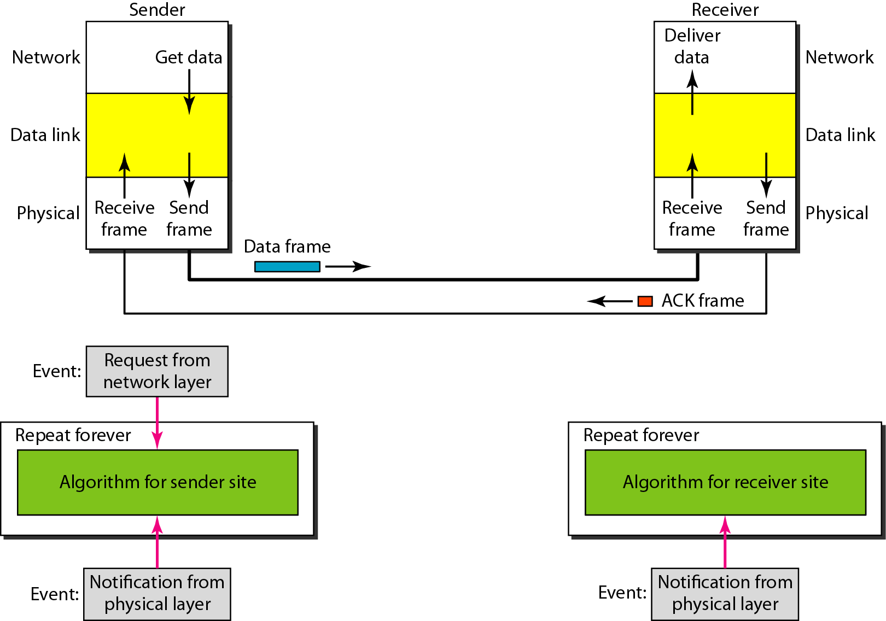
Design of Stop-and-Wait Protocol

Slide 43
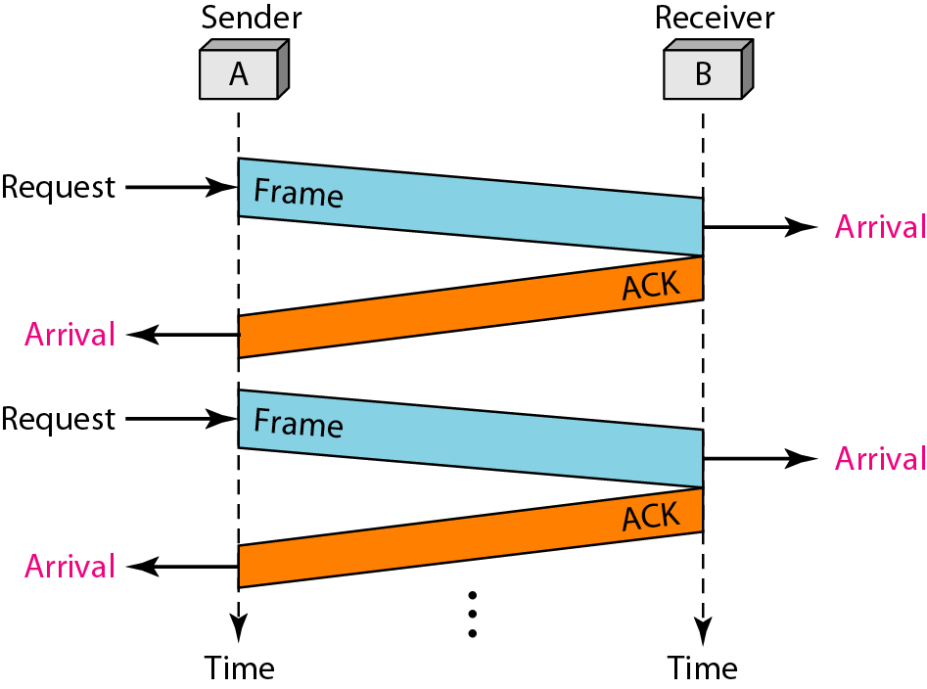
Flow diagram

Slide 44
NOISY CHANNELS
Although the Stop-and-Wait Protocol gives us an idea of how to add flow control to its predecessor, noiseless channels are nonexistent. We discuss three protocols in this section that use error control.
Stop-and-Wait Automatic Repeat Request Go-Back-N Automatic Repeat Request Selective Repeat Automatic Repeat Request

Slide 45
Error correction in Stop-and-Wait ARQ is done by keeping a copy of the sent frame and retransmitting of the frame when the timer expires.

Slide 46
In Stop-and-Wait ARQ, we use sequence numbers to number the frames.
The sequence numbers are based on modulo-2 arithmetic.

Slide 47
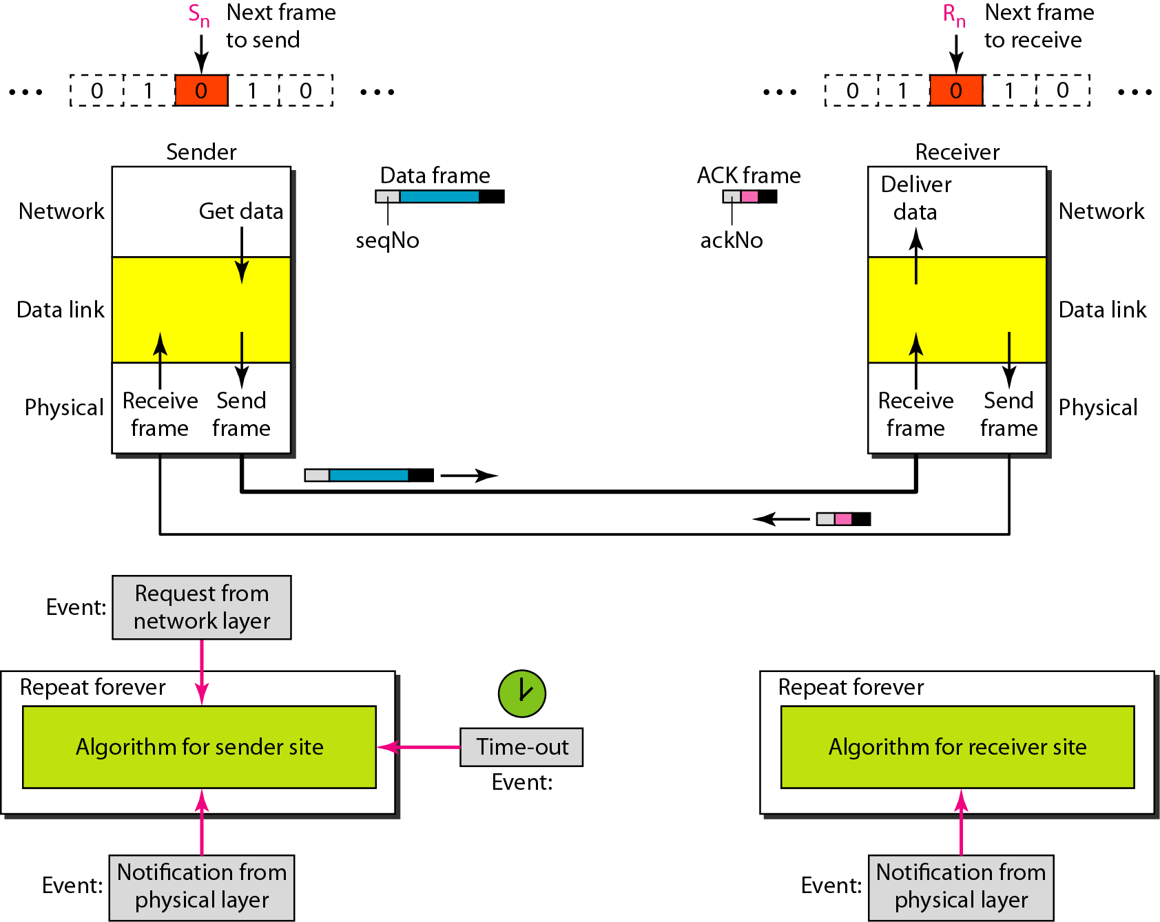
Design of the Stop-and-Wait ARQ Protocol

Slide 48
In the Go-Back-N Protocol, the sequence numbers are modulo 2^{m},
where m is the size of the sequence number field in bits.

Slide 49
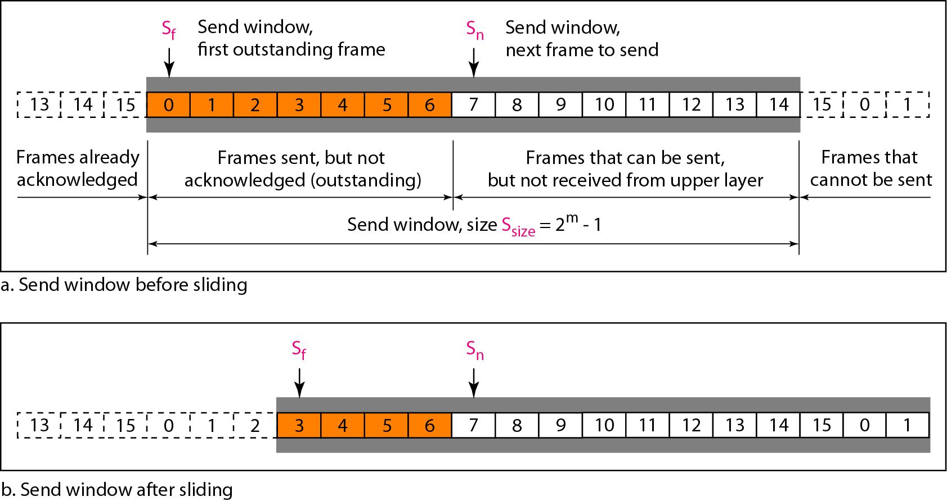
Send window for Go-Back-N ARQ

Slide 50
The send window is an abstract concept defining an imaginary box of size 2^{m} − 1 with three variables: Sf, Sn, and S_{size}.

Slide 51
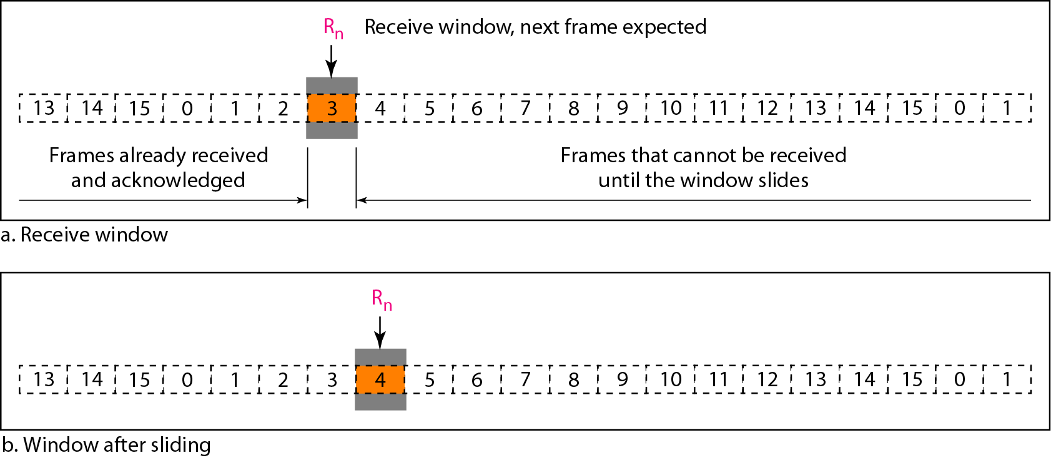
Receive window for Go-Back-N ARQ

Slide 52
The receive window is an abstract concept defining an imaginary box
of size 1 with one single variable R_{n}. The window slides
when a correct frame has arrived; sliding occurs one slot at a time.

Slide 53
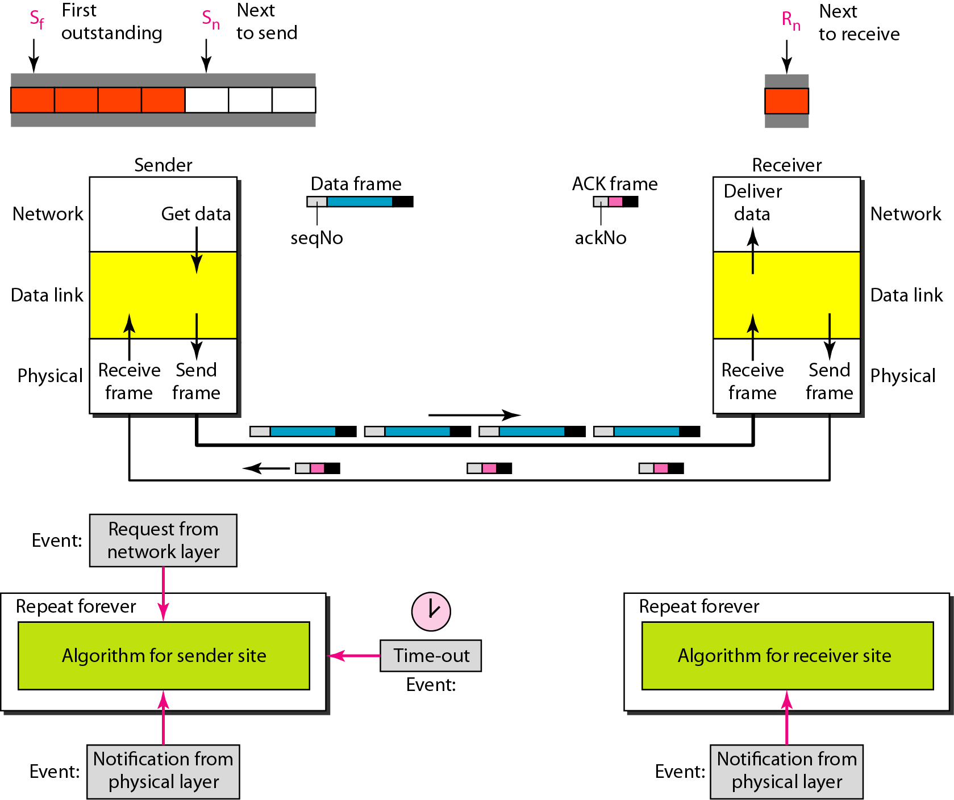
Design of Go-Back-N ARQ

Slide 54
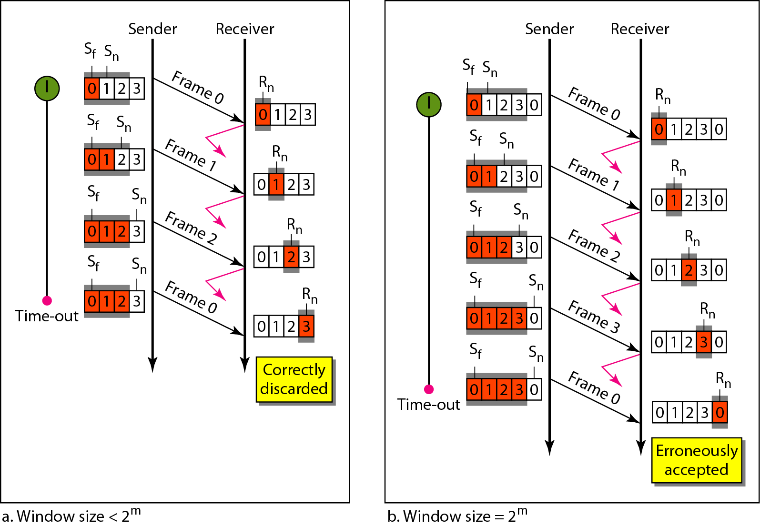
Window size for Go-Back-N ARQ

Slide 55
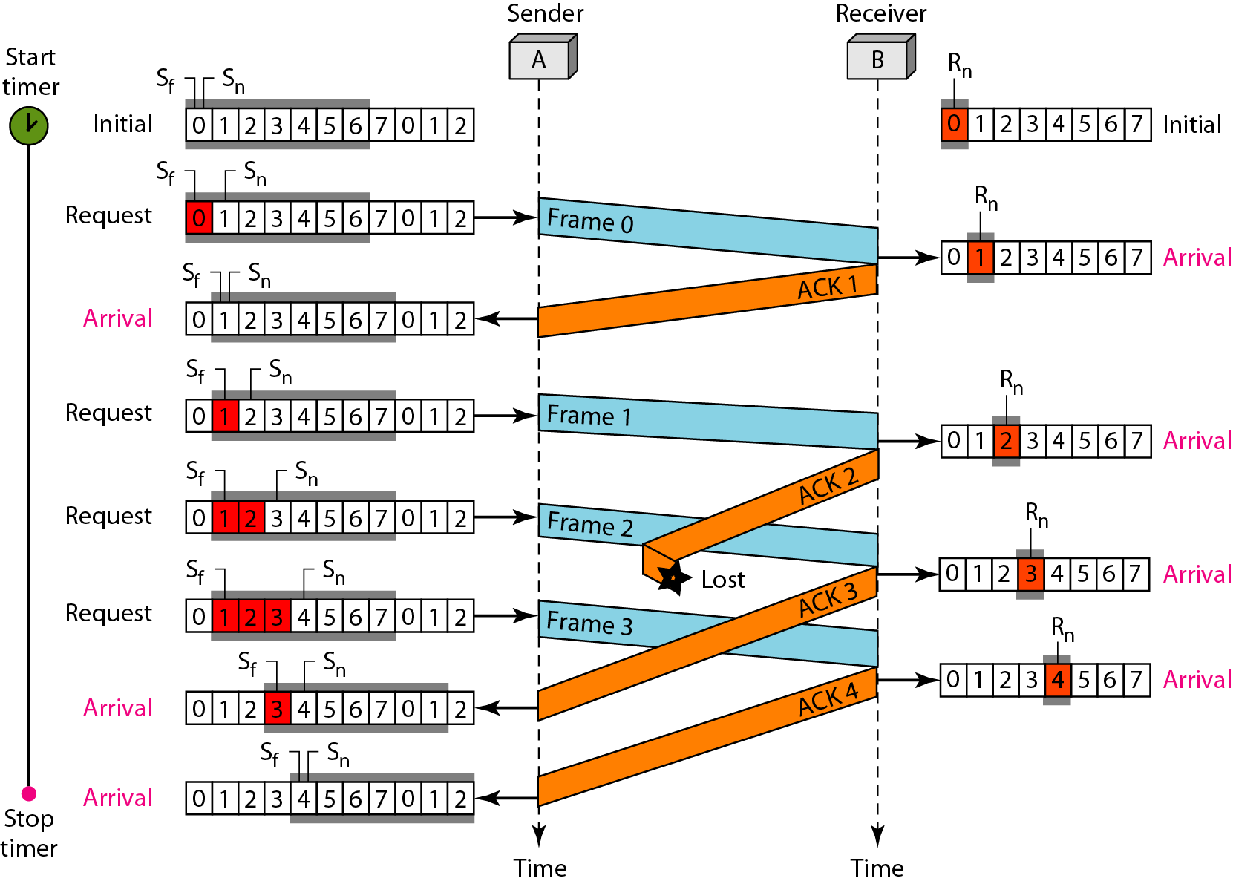
Flow diagram

Slide 56
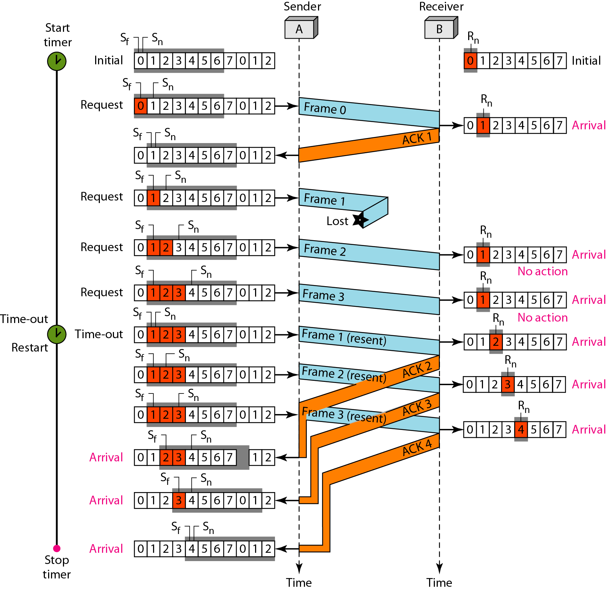
Flow diagram

Slide 57
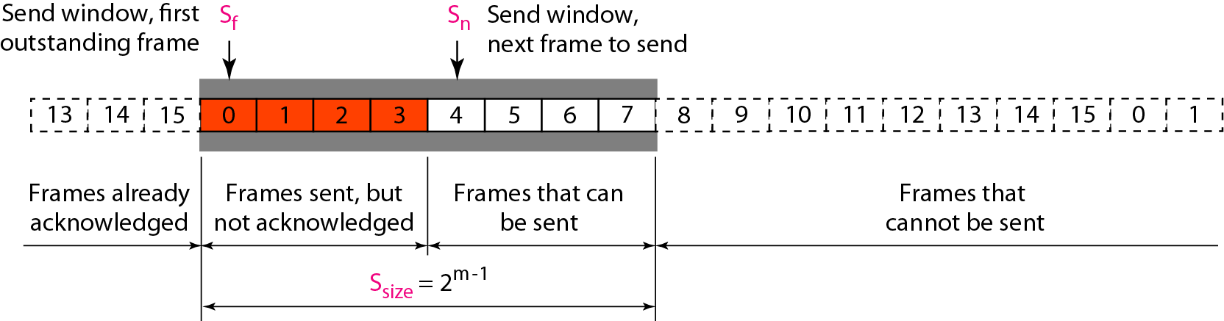
Send window for Selective Repeat ARQ

Slide 58
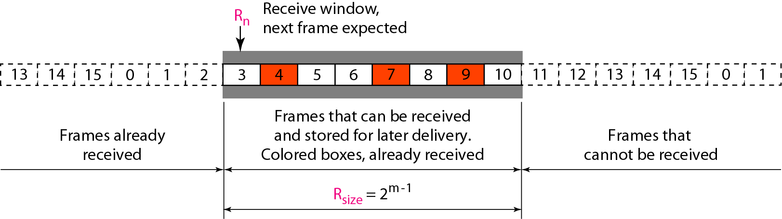
Receive window for Selective Repeat ARQ

Slide 59
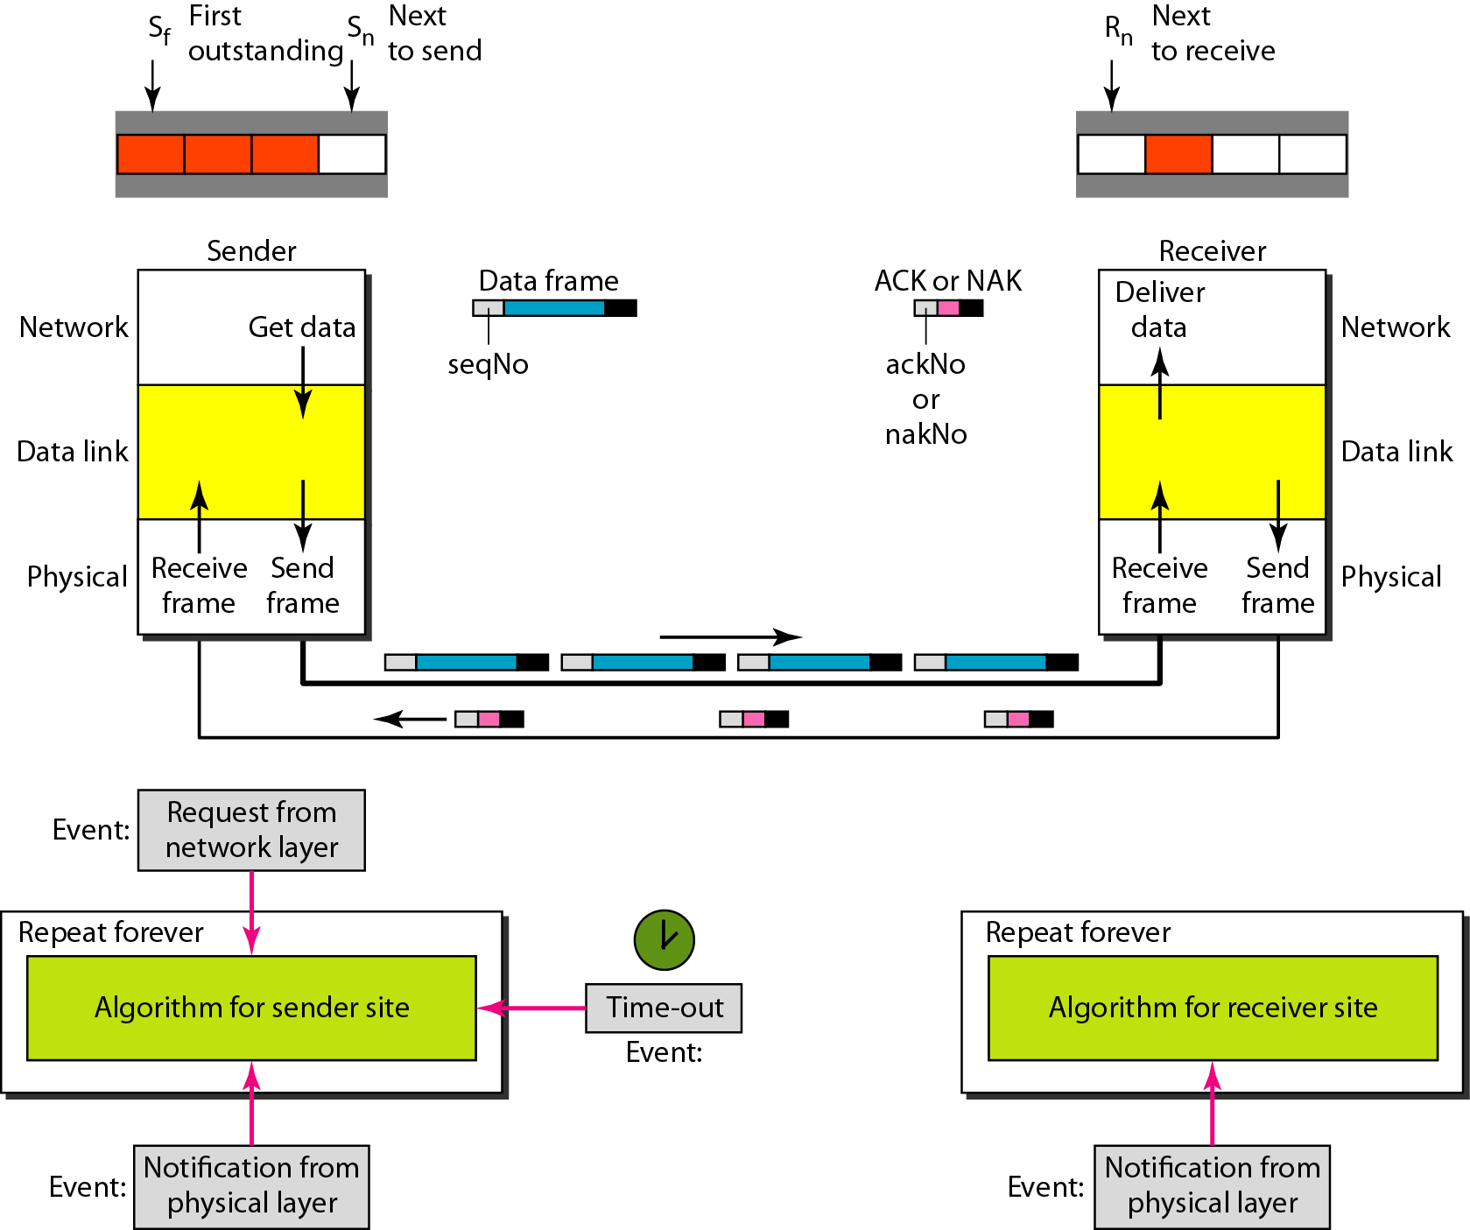
Design of Selective Repeat ARQ

Slide 60
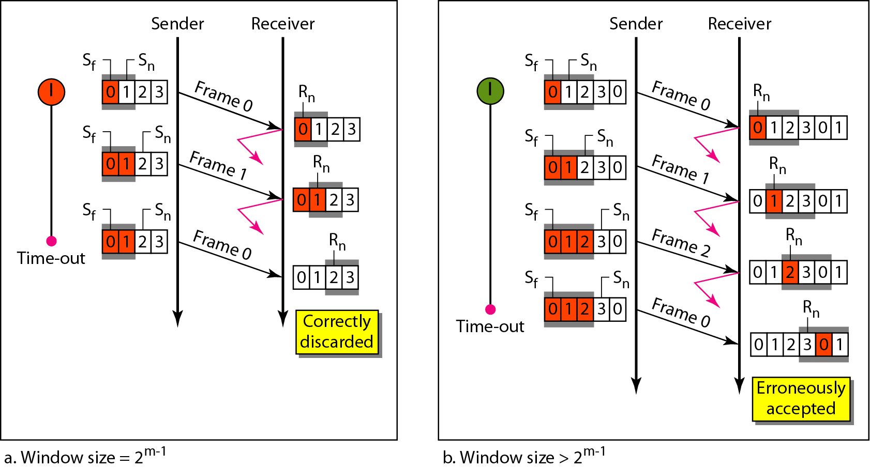
Selective Repeat ARQ, window size

Slide 61
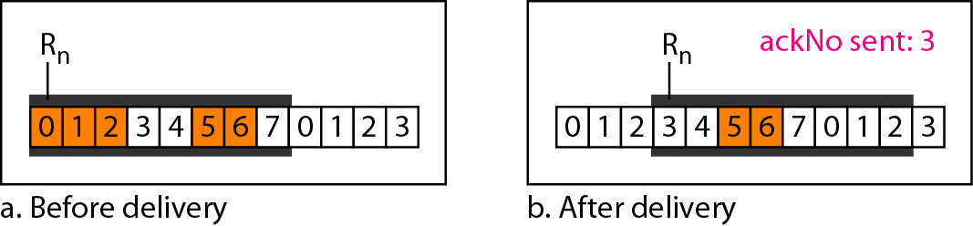
Delivery of data in Selective Repeat ARQ

Slide 62
HDLC
High-level Data Link Control (HDLC) is a bit-oriented protocol for communication over point-to-point and multipoint links. It implements the ARQ mechanisms
Configurations and Transfer Modes Frames Control Field

Slide 63
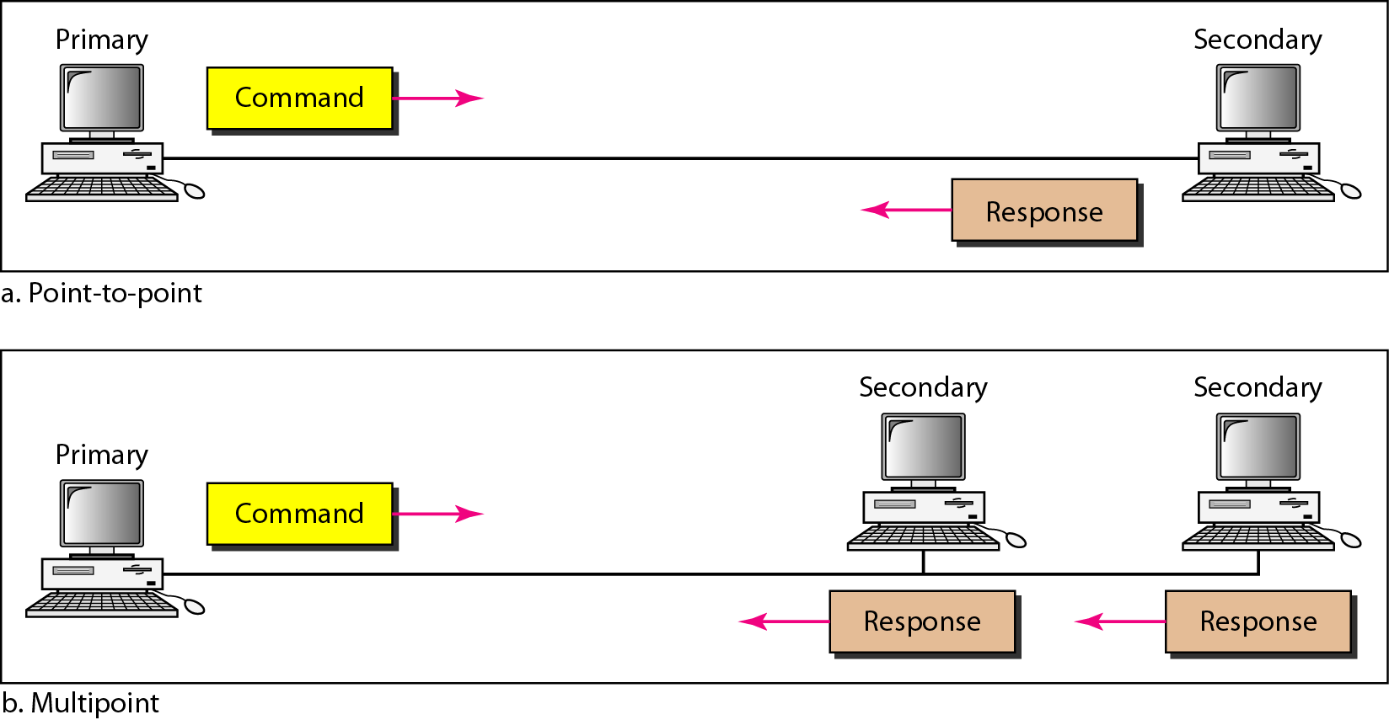
Figure 11.25 Normal response mode

Slide 64
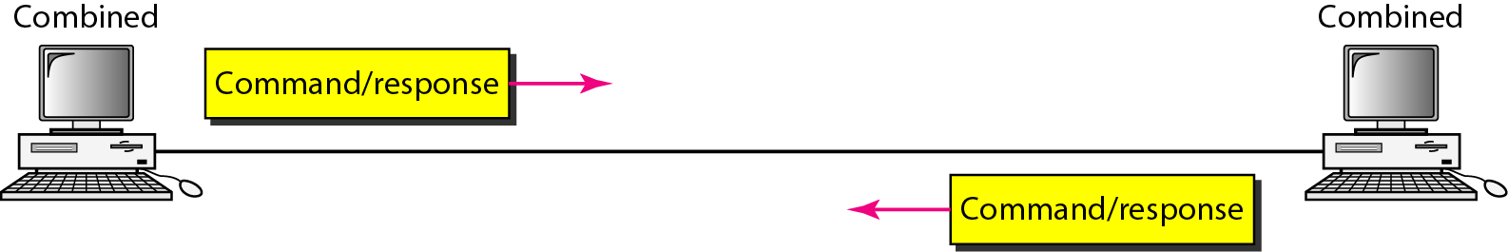
Asynchronous balanced mode

Slide 65
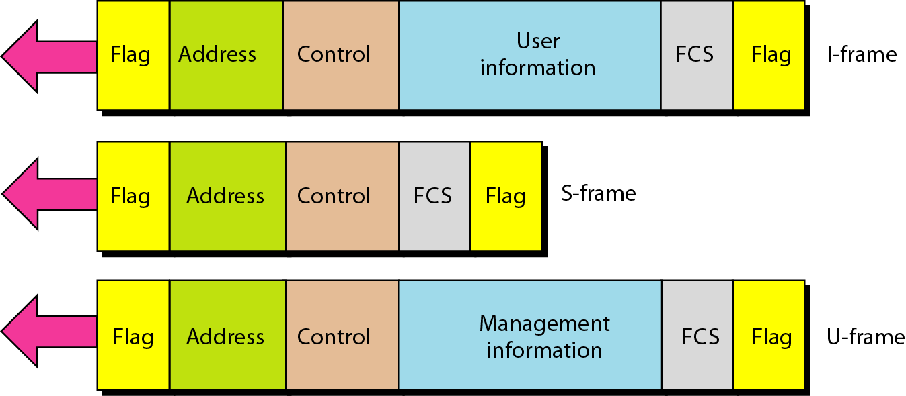
HDLC frames

Slide 66
S-Frames
Receive Ready(RR)
Receive Not Ready(RNR)
Reject (REJ)
Selective Reject(SREJ)

Slide 67
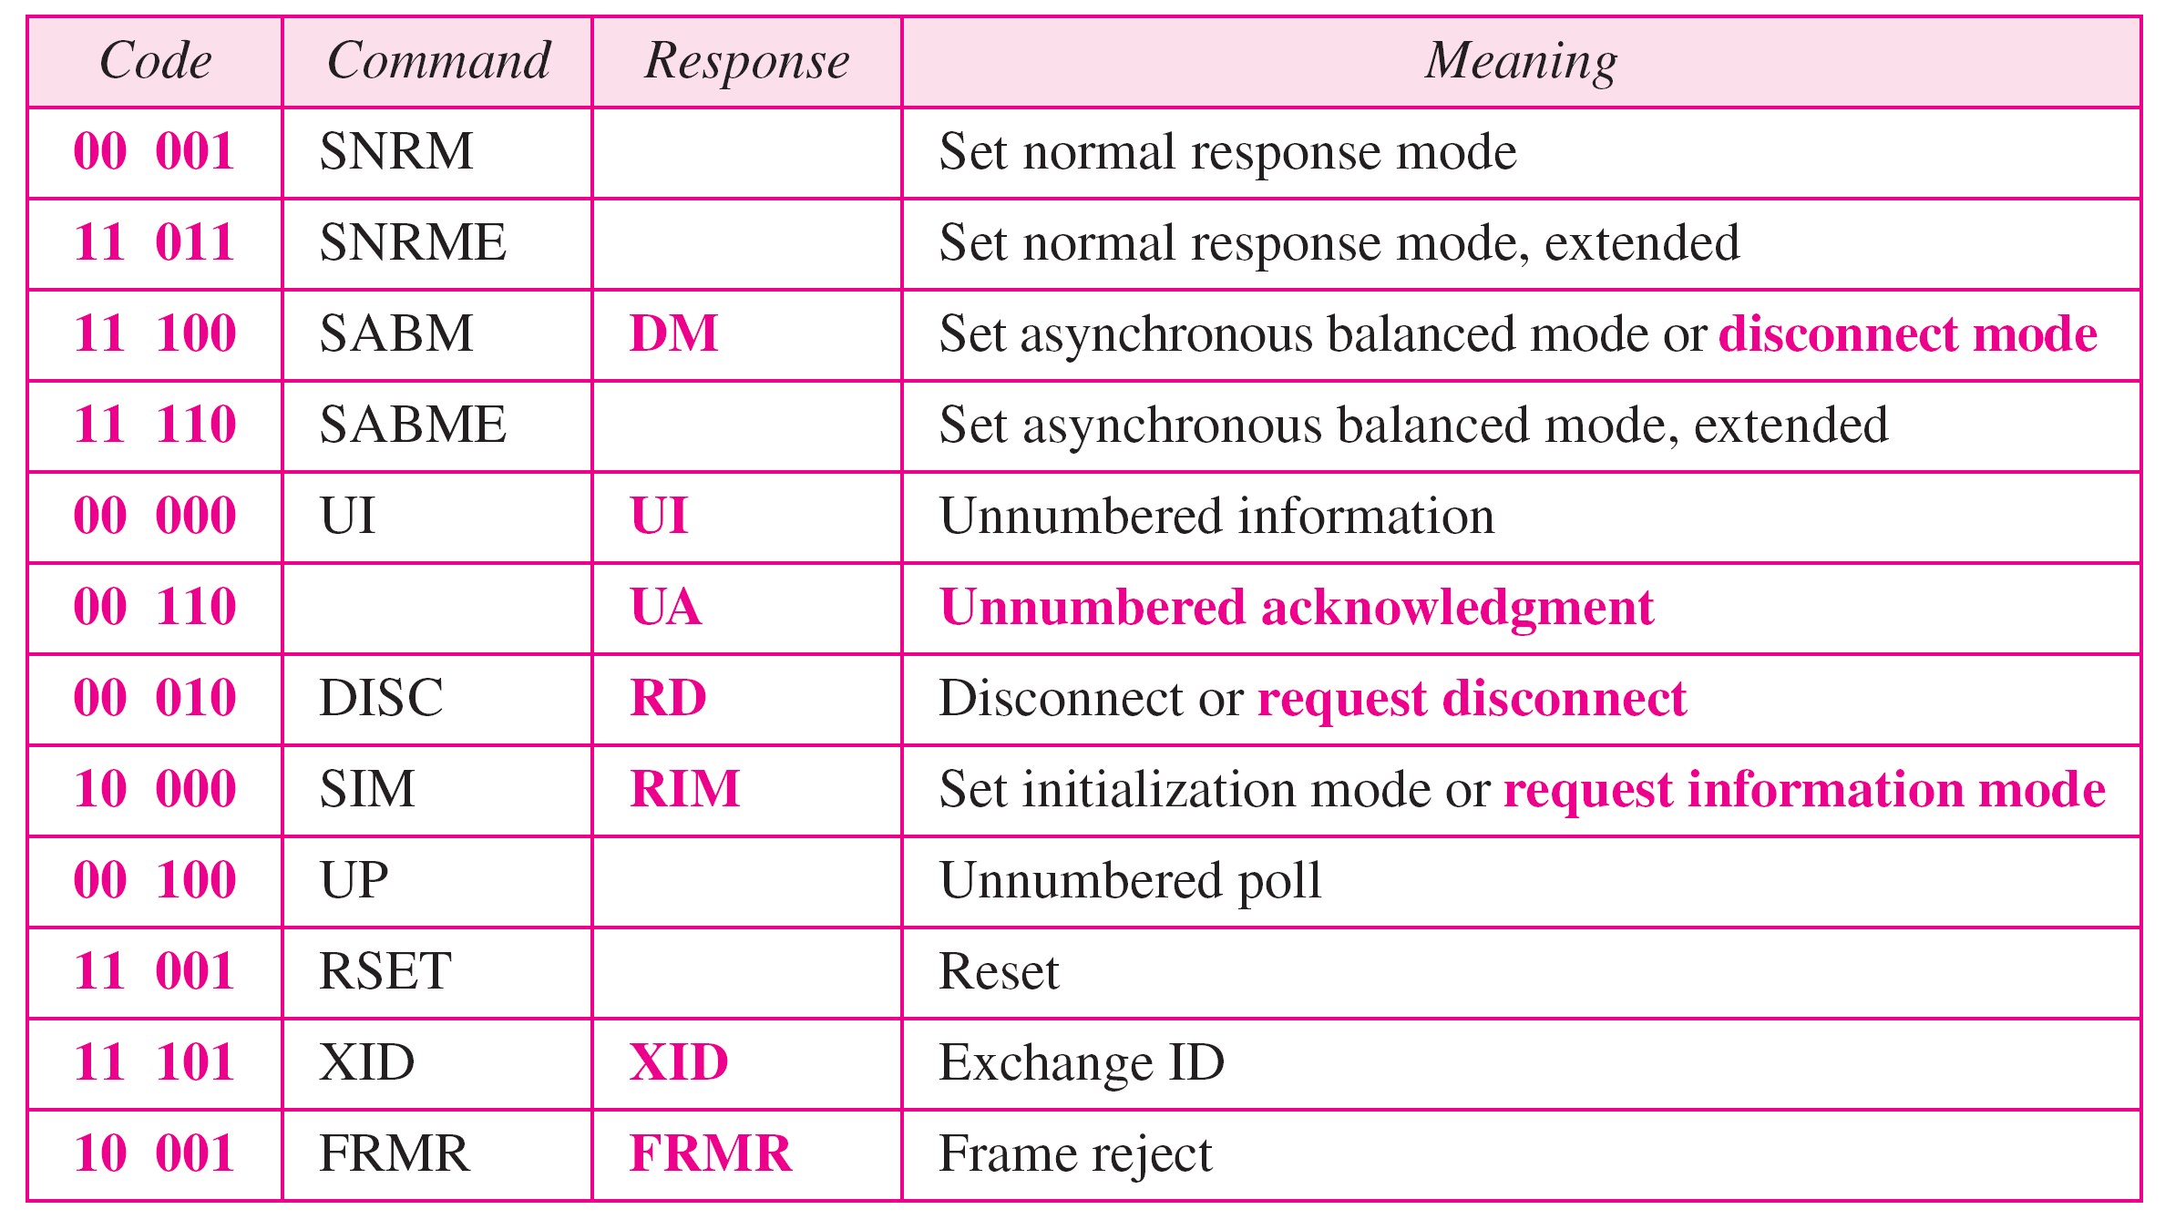
U-frame control command and response

Slide 68
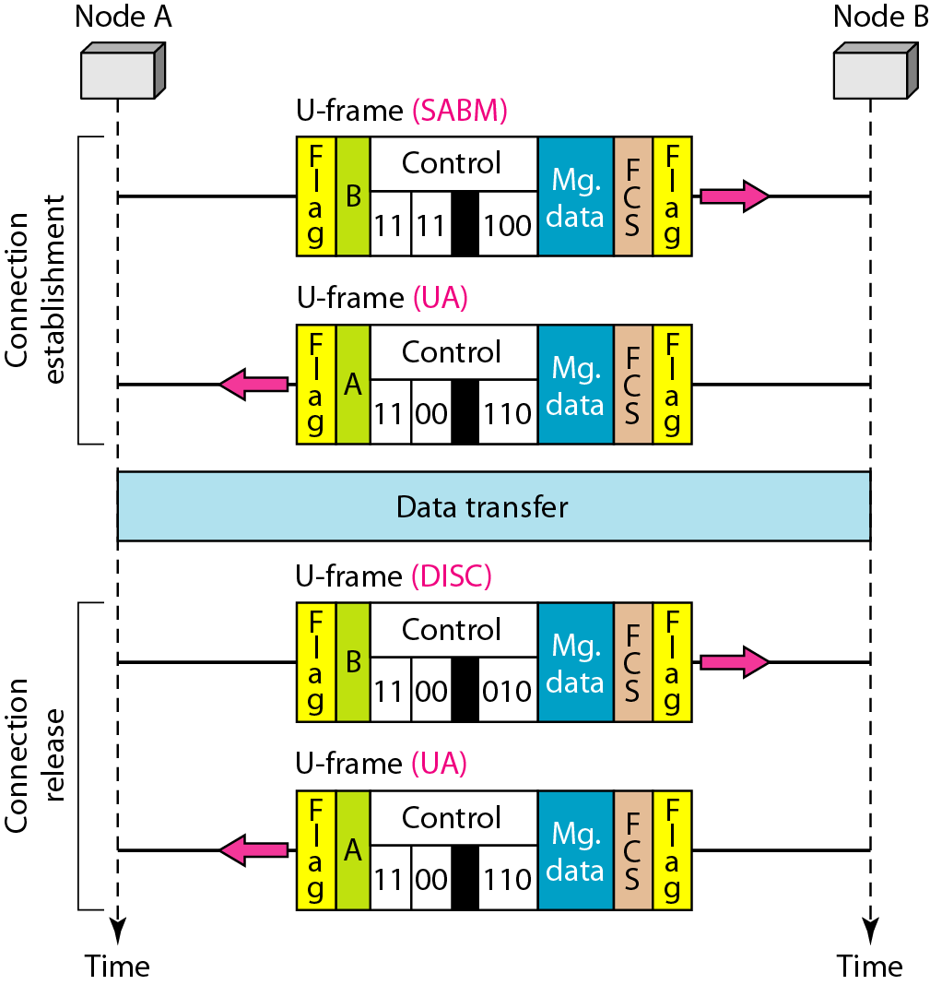
Example of connection and disconnection

Slide 69
POINT-TO-POINT PROTOCOL
Although HDLC is a general protocol that can be used for both point-to-point and multipoint configurations, one of the most common protocols for point-to-point access is the Point-to-Point Protocol (PPP). PPP is a byte-oriented protocol.
Framing
Transition Phases

Slide 70
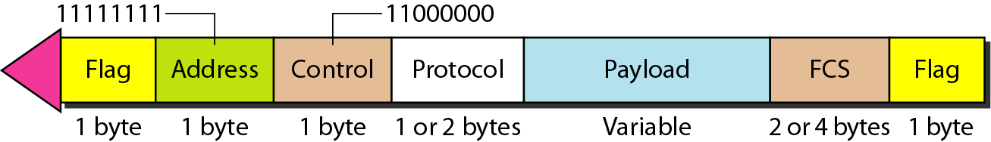
PPP frame format

